Slide 1
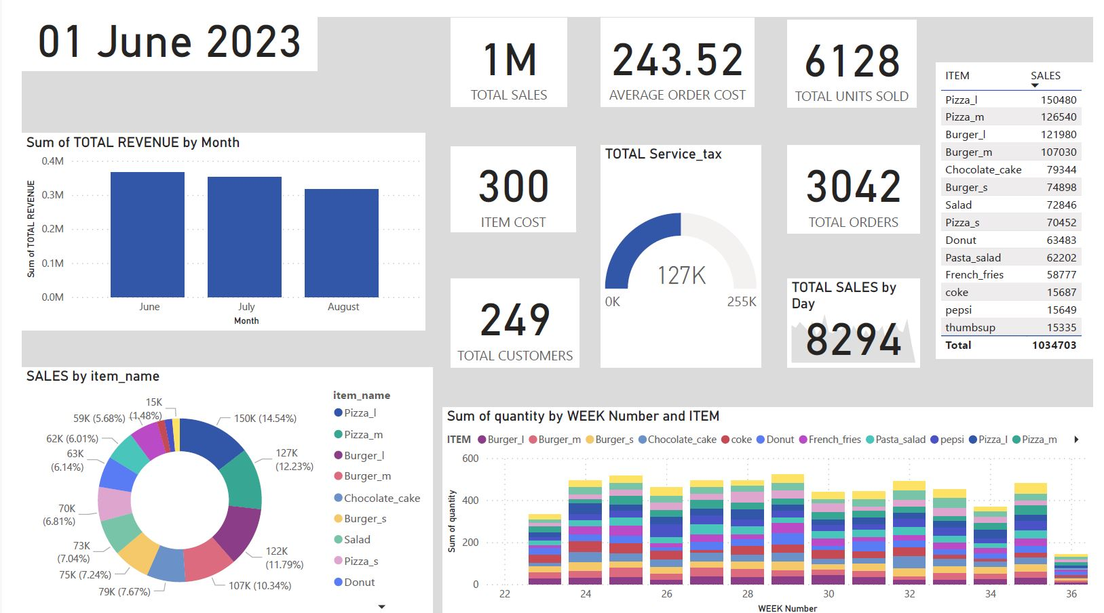
SALES OVERVIEW

Slide 2
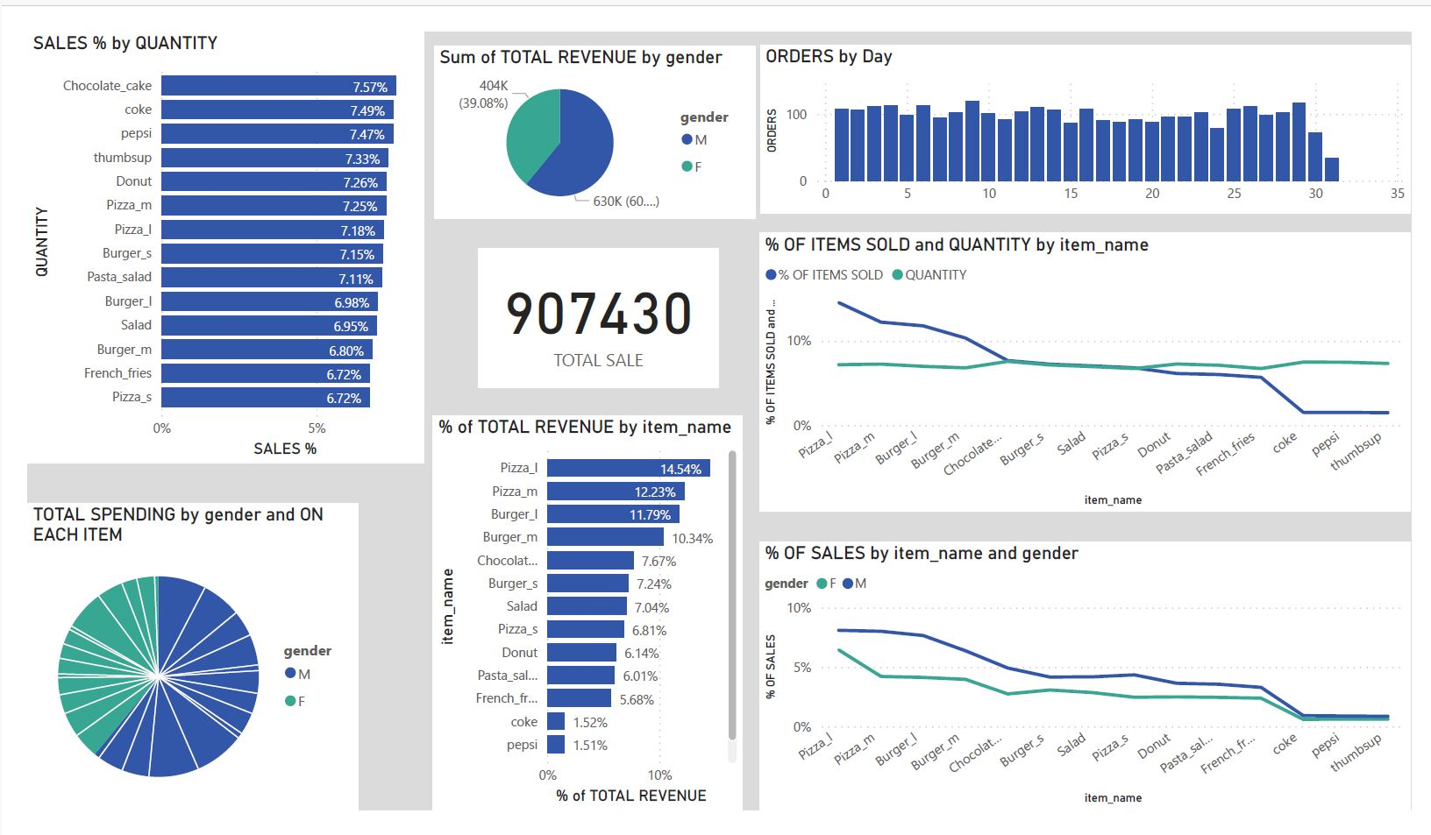
PRODUCT PERFORMANCE

Slide 3
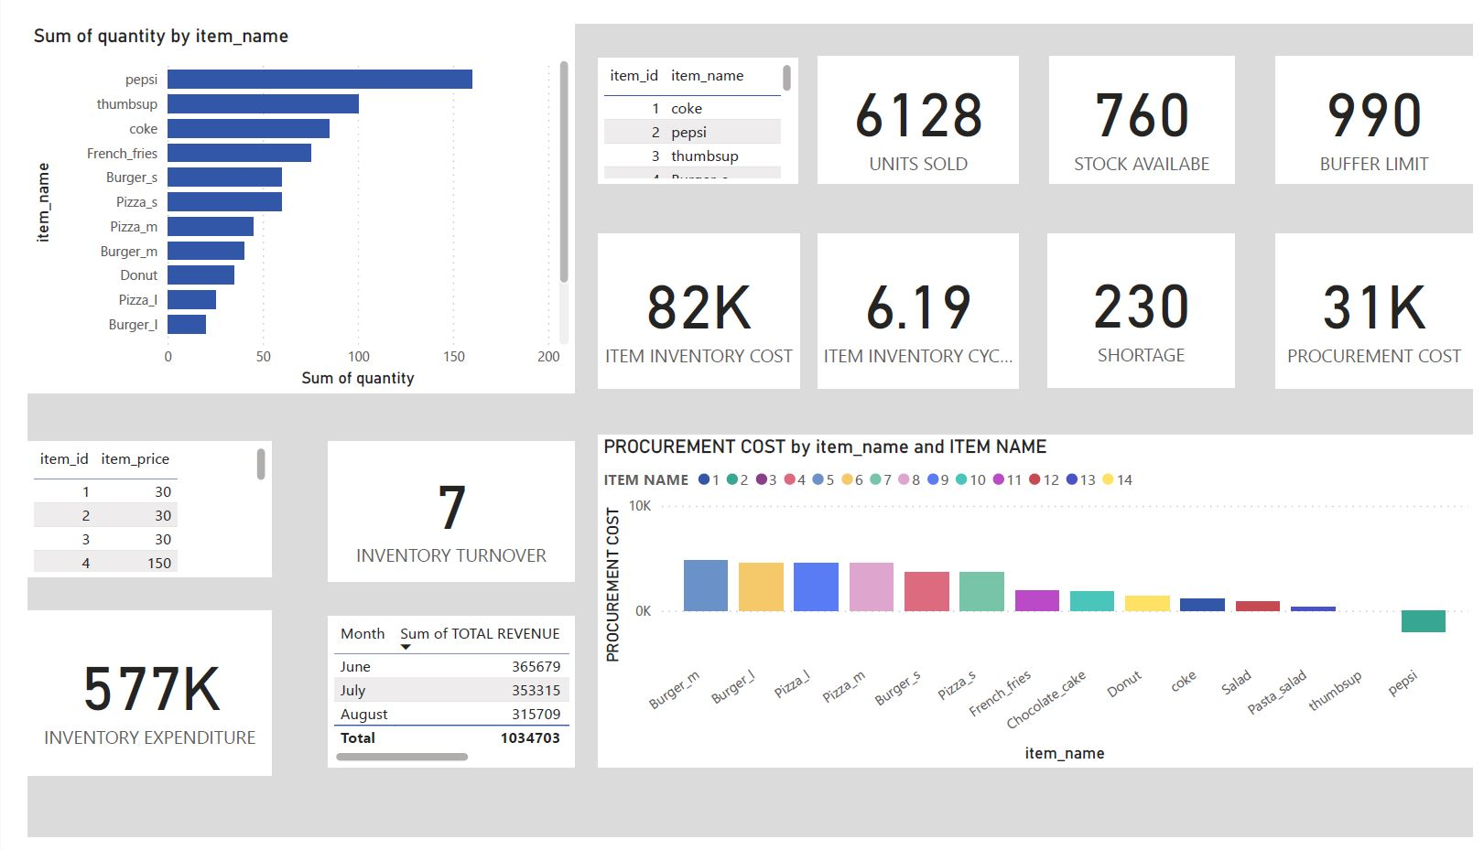
INVENTORY STATUS

Slide 4
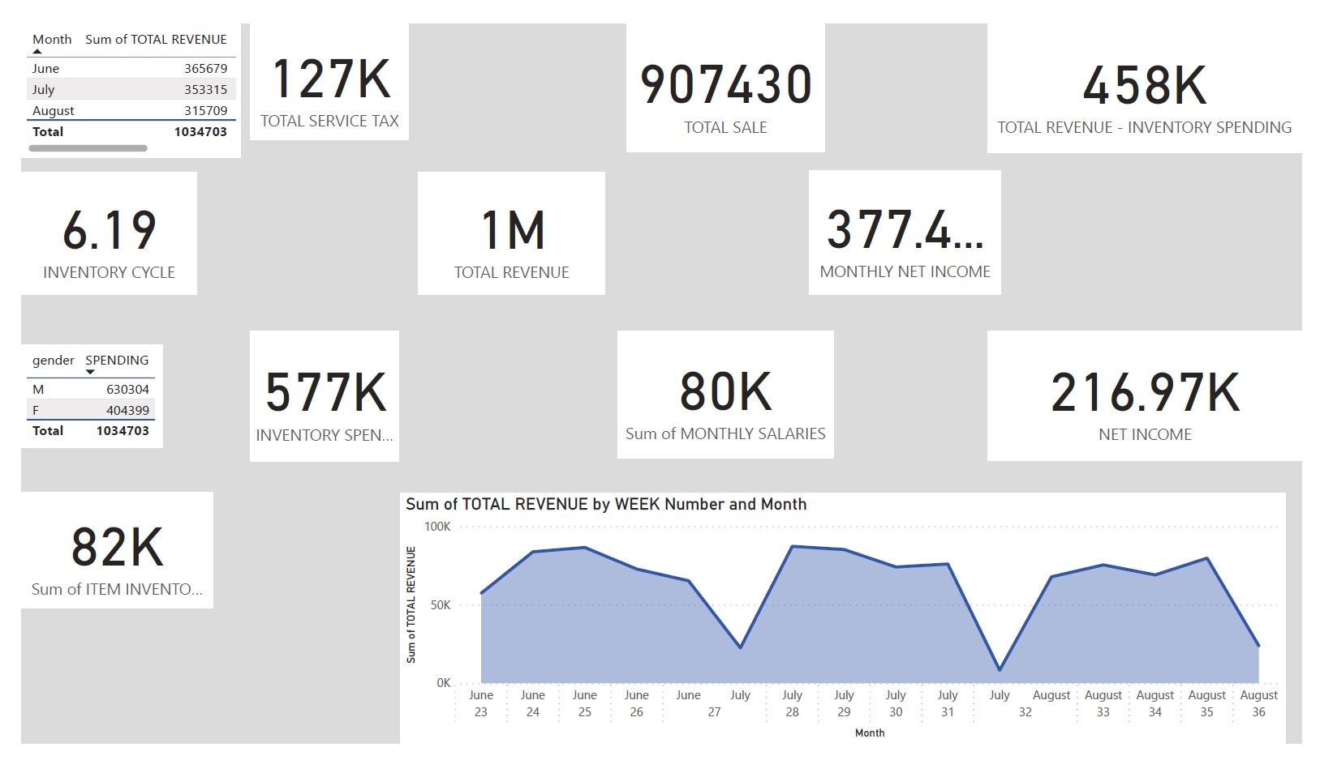
BALANCE STATEMENT

